Slide 1
Tues 1.27, Wed 1.28 & Thurs 1.29
Genetics Do now #2: Having a cleft chin is dominant (H) and not having a cleft chin is recessive (h). In a family, the mother does not have a cleft chin. The oldest daughter does not have a cleft chin, but the younger daughter does. What are the genotypes of the mother and father in this cross? (Set-up a Punnett square to solve)

Slide 2
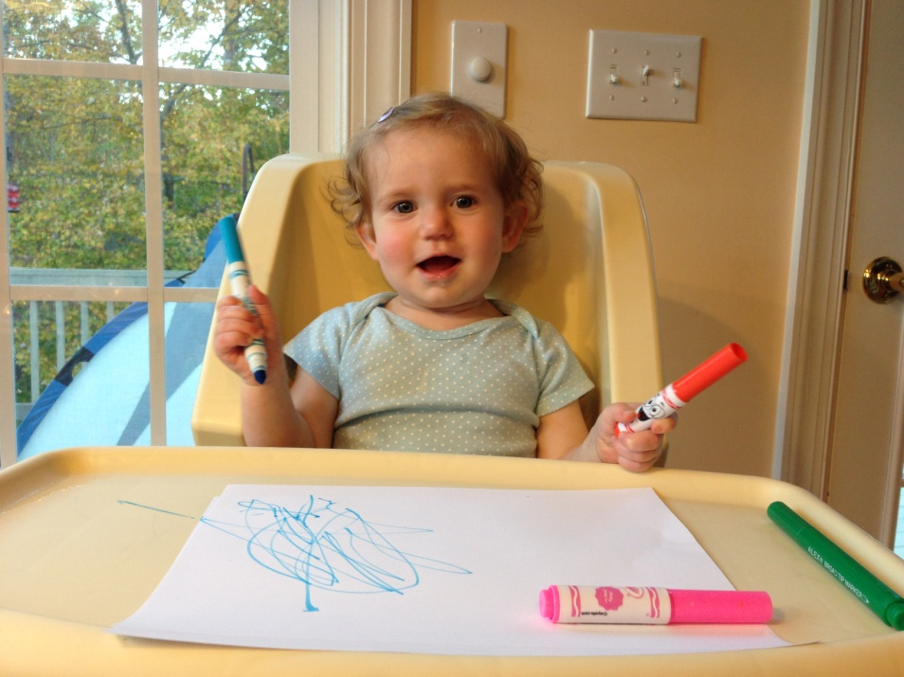
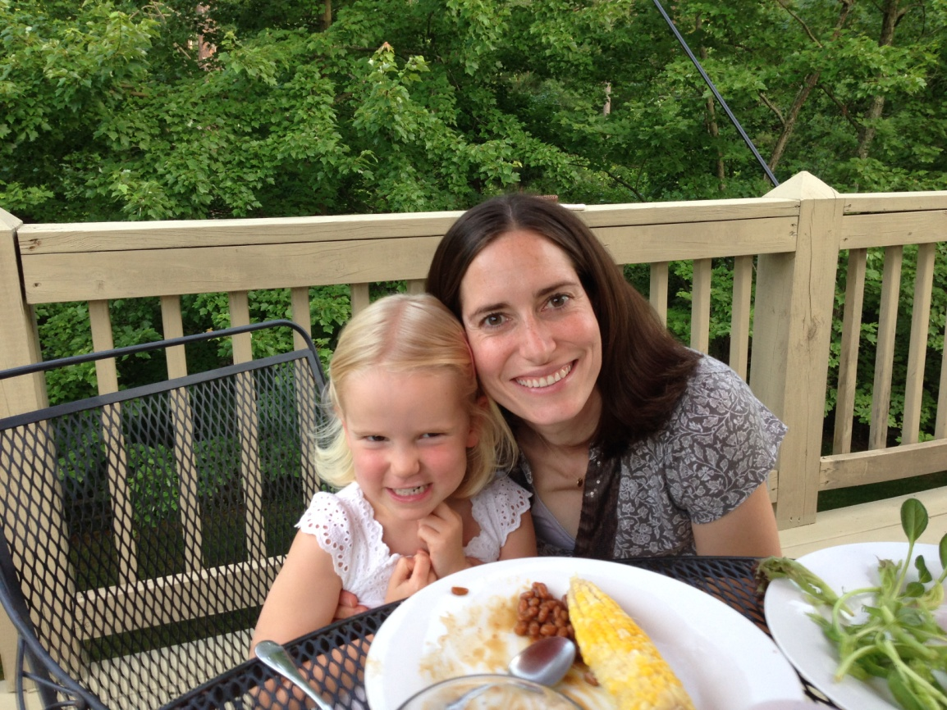
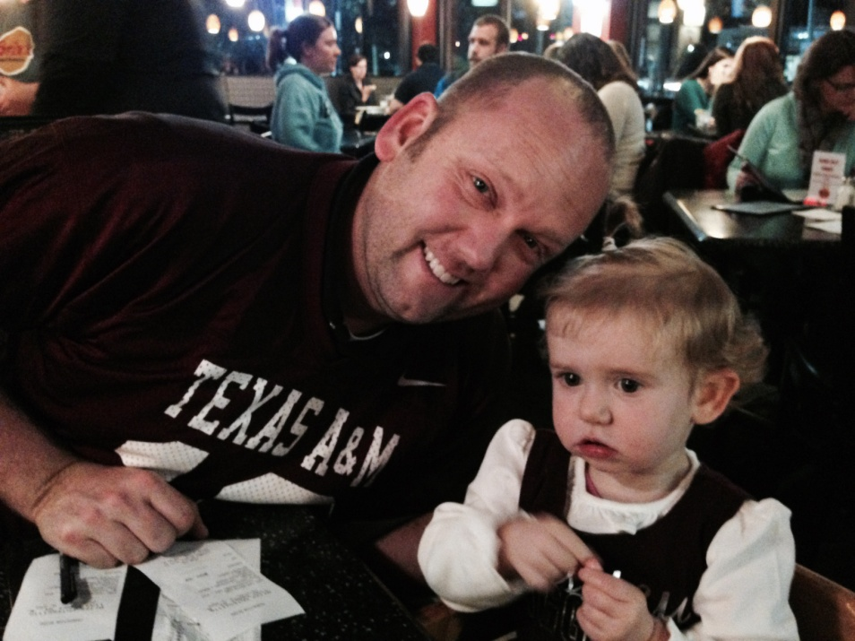
Mother—hh
Father—Hh
Elis—
Ada--

Slide 3
Mother—hh
Father—Hh
Elis—hh
Ada--Hh
 | h | h
H | Hh | Hh
h | hh | hh

Slide 4
