Slide 1
Friday 1.9.15 & Monday 1.12.15
Do now #3: (Protein Synthesis & Meiosis Unit) What type of cells would you expect to be haploid (containing half the number chromosomes)?
Take Protein Synthesis Quiz
Meiosis introduction—Amoeba sisters
Meiosis online activity
HW: Mutation worksheet

Slide 2
Friday 1.9.15 & Monday 1.12.15
Do now #3: (Protein Synthesis & Meiosis Unit) What type of cells would you expect to be haploid (containing half the number chromosomes)? Gametes (Reproduction cells), egg & sperm cells in humans. (EX: 23 chromosomes in egg cell + 23 chromosomes in sperm cell = 46 chromosomes in zygote (first cell)
Take Protein Synthesis Quiz
Meiosis introduction—Amoeba sisters
Meiosis online activity
HW: Mutation worksheet

Slide 3
Do now #4 1.15.15 Protein Synthesis & Meiosis Unit
Crossing-over occurs in Prophase I of Meiosis. What happens during crossing-over, and what does the process of crossing over contribute to?
Homework: Mutation Worksheet

Slide 4
Do now #4 1.15.15 Protein Synthesis & Meiosis Unit
Crossing-over occurs in Prophase I of Meiosis. What happens during crossing-over, and what does the process of crossing over contribute to?
The homologous chromosomes exchange genes (segments of the chromosome), and this results in recombinant chromosomes (unique chromosomes).
This process results in genetic diversity. This contributes to the survival of the species and provides potential positive innovations in the population.
Homework: Mutation Worksheet

Slide 5
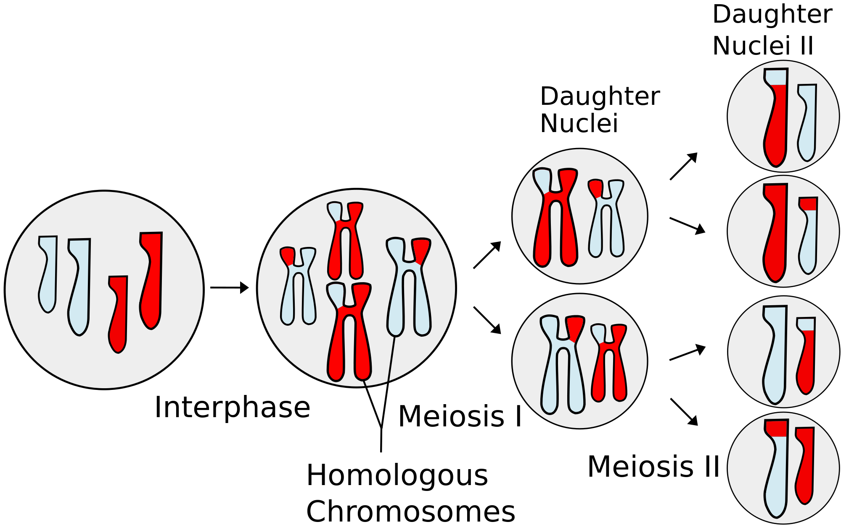
Meiosis

Slide 6
Mutations
Mutations are any random change in the DNA sequence
Mutations can have a positive effect, a negative effect, or no effect at all
Gene mutations affect a single nucleotide
Chromosomal mutations affect either an entire section of a chromosome or an entire chromosome

Slide 7
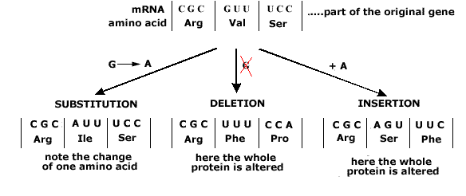
Gene Mutations
Gene mutations

Slide 8
Gene Mutations

Slide 9
Chromosomal Mutations

