Slide 1
Welcome back! Monday 1.5.15
Do now #1: Protein synthesis and meiosis
Proteins are produced on the ____________

Slide 2
Welcome back! Monday 1.5.15
Do now #1: Protein synthesis and meiosis
Proteins are produced on the ribosome

Slide 3
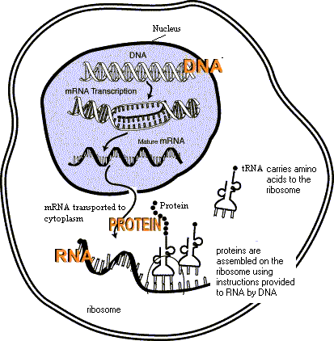

Slide 4
Animation
https://www.youtube.com/watch?v=GigxU1UXZXo

Slide 6
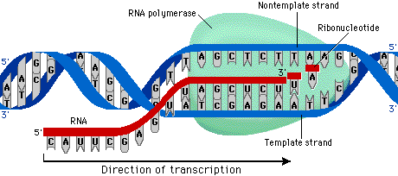
Transcription

Slide 7
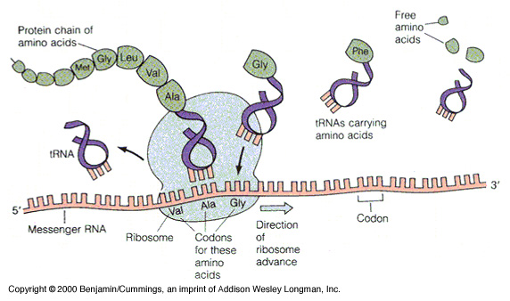
Translation

Slide 8
Transcribe the following code
DNA: TAC GGA GAT CAG CAT ATC

Slide 9
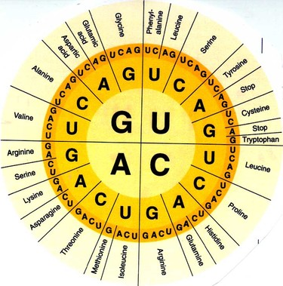
Transcribe the following code
TAC GGA GAT CAG CAT ATC
AUG CCU CUA GUC GUA UAG
Now, Translate the code

Slide 12
Transcribe the following code
TAC GGA GAT CAG CAT ATC
AUG CCU CUA GUC GUA UAG
Now, Translate the code
Met-Pro-Leu-Val-Val-Stop

Slide 13
Ad Homework
Read section 12-3 (pages 300-306) AND
answer questions 1-5 on page 306 (Q &A)

Slide 14
Honors HW Due Wed 1.7.15
Read pages 180-190 (Starting with the flow of genetic information…)
Answer checkpoint questions on page 190, writing the questions and answers. (Rephrasing the question is fine, but write answers in your own words!)

