Slide 1
Thursday 1.8.15
Do now 2: (Protein Synthesis & Meiosis) Translate the following DNA code into the amino acid sequence
DNA: TACCAGGACAATTCCGCT
2. Check and go over homework
3. Label Translation Diagram
4. Finish Gizmo
HW: Study for quiz on Protein Synthesis (Transcription & Translation)

Slide 2
Wednesday 1.7.15
Do now 2: (Protein Synthesis & Meiosis) Translate the following DNA code into the amino acid sequence
DNA: TAC CAG GAC AAT TCC GCT
mRNA: AUG GUC CUG UUA AGG CGA
Methionene(Start) - Valine - Leucine - Leucine – Arginine - Arginine
2. Check homework
3. Diagram
4. Finish Gizmo
HW: Study for quiz on Protein Synthesis (Transcription & Translation)

Slide 3
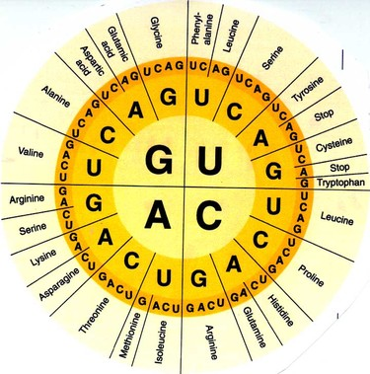

Slide 4
Checkpoint questions p. 190
Transcription—the transfer of genetic information from DNA into RNA
Translation—The transfer of the information
in the RNA into a protein
DNA participates in transcription, the first
step
Frameshift mutation, shifts all of the codons
beyond the point of the mutation

Slide 5
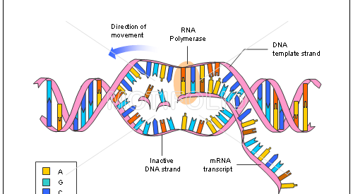

Slide 6
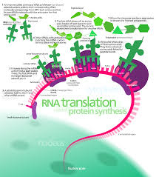

Slide 7
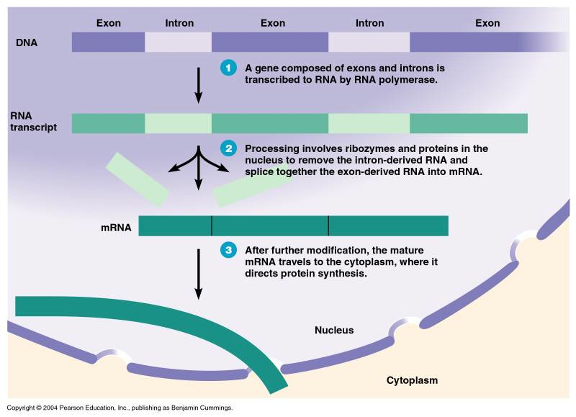

Slide 8
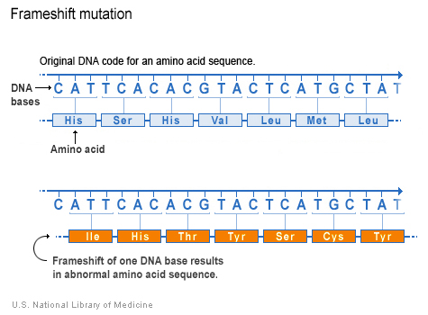

Slide 9
1. 3 types of RNA
mRNA—messenger RNA
rRNA--Ribosomal RNA
tRNA--Transfer RNA
2. Summary of transcription—The DNA code of one gene is copied by the mRNA molecule
3. Translation—The mRNA provides the code for correct amino acids to be joined together to form a specific protein on the ribosome
4. 3 main differences between DNA & RNA
1. RNA contains ribose sugar rather than
deoxyribose sugar in its backbone
2. RNA is single stranded, DNA is double stranded
3. RNA contains uracil (nitrogenous base) rather than
thymine
5. UGG CAG UGC

