Slide 1
The Scientific Method
Do Now—Complete the activity on your desk

Slide 2
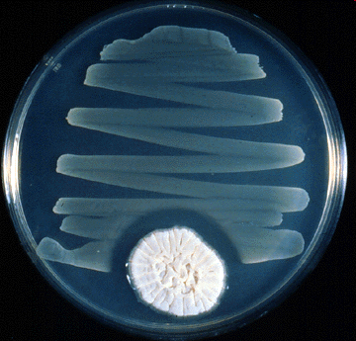

Slide 3
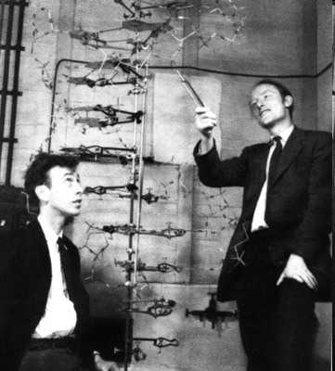

Slide 4
Agenda
1. Do now
2. Finish lab safety activities & go over
3. Observation practice & demo
4. Scientific method & experimental design notes
5. Metric system & scientific notation
6. Latin & Greek roots

Slide 5
Make observations about the following everyday object
Remember to use your senses

Slide 6
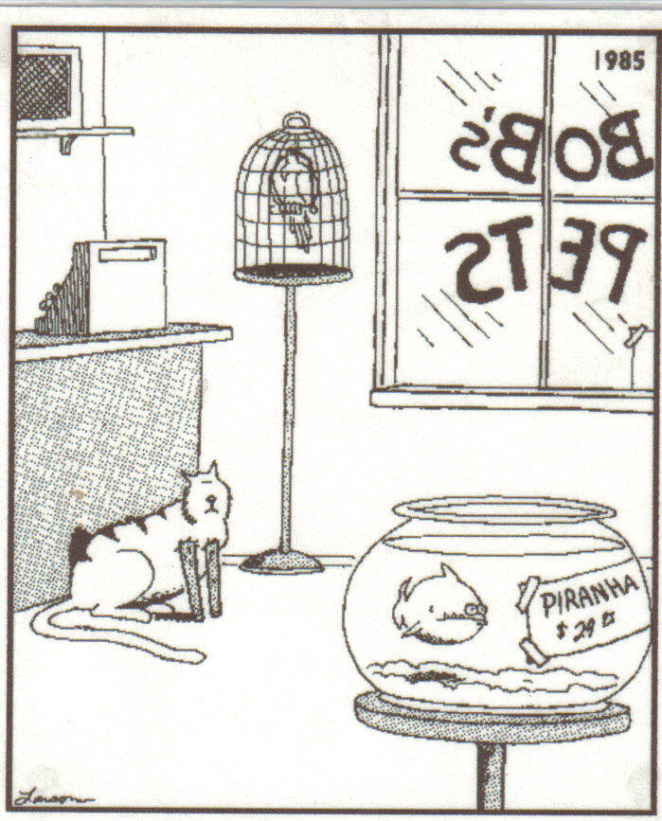
Observation vs. Inference
You make observations directly with your 5 senses
Inferences are conclusions based on observations and your background knowledge & experience

Slide 7
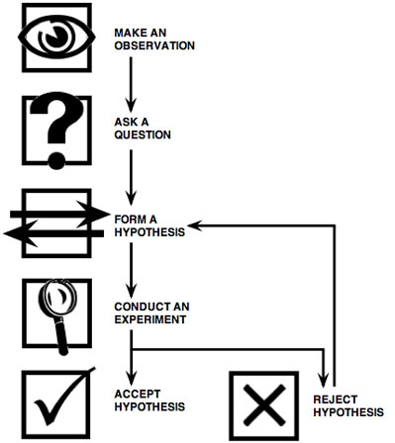
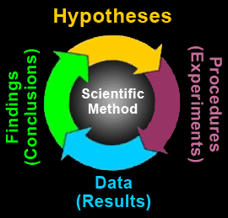
Scientific Method

Slide 8
Quanitative vs. Qualitative Data
Quantitative—Counted or Measured
Qualitative--Descriptive
A green lizard
A large bird
A population of 25 robins
A 25 centimeter long organism
Lots of insects
A small group of mammals

Slide 9
Quanitative vs. Qualitative Data
A green lizard---qualitative
A large bird---qualitative
A population of 25 robins---quantitative
A 25 centimeter long organism---quantitative
Lots of insects---qualitative
A small group of mammals---qualitative

Slide 10
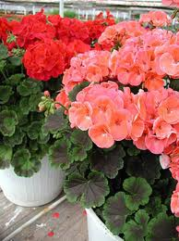
Experimental Design
Three biology students are studying the effect of the type of fertilizer on plant growth. They 15 grow geraniums in separate pots, but make sure to use the same soil, the same amount of water, and to expose the plants to the same amount of sunlight. They treat five geraniums with one type of fertilizer, five with another type of fertilizer, and the last five with no fertilizer. They measure the plant everyday for 2 weeks. They find that the geraniums that were treated with fertilizer type A grew an average of 10 centimeters, while those treated with fertilizer type B grew an average of 20 centimeters, and those with no fertilizer grew an average of 5 centimeters.
independent variable—I change the variable
dependent variable—what you measure
constants—Anything that is kept the same
control—A group that you do not change

Slide 11
Experimental Design
Three biology students are studying the effect of the type of fertilizer on plant growth. They 15 grow geraniums in separate pots, but make sure to use the same soil, the same amount of water, and to expose the plants to the same amount of sunlight. They treat five geraniums with one type of fertilizer, five with another type of fertilizer, and the last five with no fertilizer. They measure the plant everyday for 2 weeks. They find that the geraniums that were treated with fertilizer type A grew an average of 10 centimeters, while those treated with fertilizer type B grew an average of 20 centimeters, and those with no fertilizer grew an average of 5 centimeters.
independent variable—Type of fertilizer
  I change the independent variable
dependent variable—Plant growth
  Depends on the independent variable
constants---Soil, water, sunlight, type of plant
control --the five plants treated with no fertilizer

Slide 12
Hypothesis—If you give plants type A fertilizer then they will grow more.
Conclusion—The plants treated with Type B fertilizer grew the most.

Slide 13
Homework—Study Experimental Design Notes for a short quiz

